Slide 1
Using Natural Language for Reward Shaping in Reinforcement Learning
Prasoon Goyal, Scott Niekum, Raymond J. Mooney
Presenter: Urvi Shah
27th October 2022

Slide 2
Motivation
Design reward functions that accurately and efficiently describe tasks.
Reward shaping – giving agents intermediate rewards for progress towards goals.
How to design appropriate reward functions which are not difficult and easy to specify?
How are reward functions normally designed?
Sparse Rewards
Dense Rewards

Slide 3

Motivation
Sparse Rewards:
Agent has to reach a goal and only receives a positive reward signal when it is close enough to the target.
The agent won’t get any feedback about whether the instantaneous actions that it takes are good or bad!
It can spend significant amount of time exploring an environment to learn a particular behavior.

Slide 4
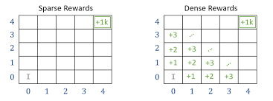
Motivation
Dense Rewards:
Reward function that gives value to most of the transitions, thus the agent gets feedback at almost every time step.
However, they are significantly more difficult to specify.

Slide 5

Proposed Idea
Give the agent intermediate rewards for progress towards goal.
Use natural language to provide dense rewards to RL agents in a manner that are easy to specify.
For e.g.,
By giving natural language instructions like “Jump over the skull while going to the left”, we can give intermediate signals to the agent for faster learning.

Slide 6
Limitations of Prior Work
Learning to parse natural language to grounded reward functions with weak supervision.
Use a predefined set of objects, object properties and spatial relations, which is difficult to scale to more complex environments and instructions.
Guiding a reinforcement learner with natural language advice: Initial results in robocup soccer.
Requires efforts to scale to complex environments for evaluating how each rule affects different probabilities of different actions. Requires additional manual effort.
Learning to follow language instructions with adversarial reward induction.
They learn linguistic features jointly during reinforcement learning, not a realistic approach if the interaction with the environment is expensive.
Notes:
Two types of prior approaches: RL to solve NLP tasks and use of NL to aid RL
Learning to parse natural language to grounded reward functions with weak supervision - Map language to reward function in object-oriented framework
Guiding a reinforcement learner with natural language advice: Initial results in robocup soccer - map natural language to a set of rules which are then used to increase or decrease the probability of choosing an action during reinforcement learn ing
Bahdanu - proposed an adversarial learning framework wherein a discriminator distinguishes between a fixed set of good (instruction, state) pairs and (instruction, state) pairs generated by the current policy, and this is used as a reward function to simultane- ously improve the policy.

Slide 7
Key Insights
Framework which takes arbitrary natural language and the trajectory executed by the agent -> makes prediction whether agent is following the instruction.
Speeds up learning in sparse reward setting by guiding the exploration of the agent.

Slide 8
Problem Setting
Notation:
MDP(+L) Framework: ⟨S, A, R, T, γ, l⟩
where,
Transition probabilities: T : S × A × S → [0, 1]
Reward function: R : S × A → R
Discount factor: γ < 1
Language command: l ∈ L (with L defined as the set of all possible language commands)
Optimal policy: π∗ : S → A
MDP reward function: R_{ext}
Intermediate Language Reward: R_{lang}

Slide 9
Background
Natural Language Challenges:
Symbol Grounding
Establish mapping between language objects/actions
Instructions can be incomplete
Eg: ‘Pour me some water’
Interesting read: ’Enabling Robots to Understand Incomplete Natural Language Instructions Using Commonsense Reasoning’
Involves ambiguity and variation
Eg: ‘Jump’ vs ‘Hop’
Different levels of abstraction

Slide 10
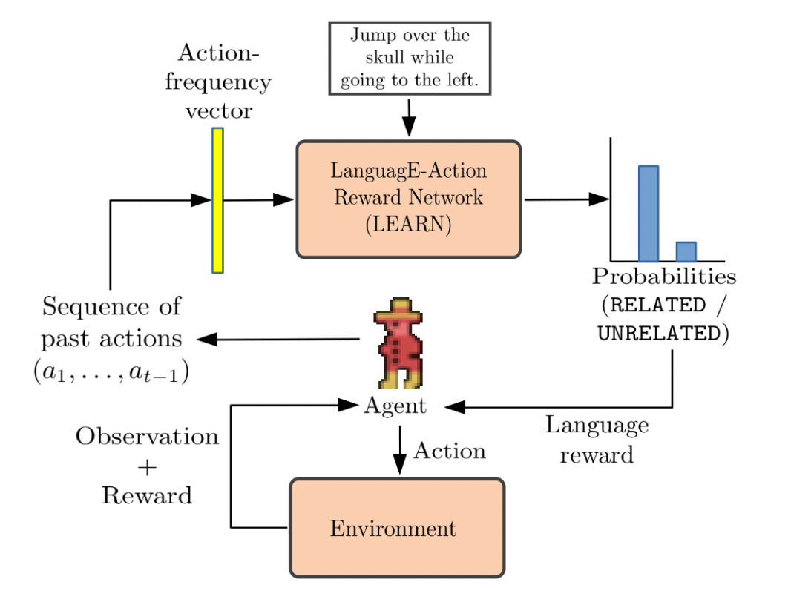
Proposed Approach / Algorithm / Method
Two phase approach
LanguagE-Action Reward Network (LEARN)
Takes paired (trajectory, language) data from the environment.
Predicts→ language describes the actions within the trajectory.
Language-aided RL
Uses RL to learn a policy for given MDP+L.
Uses prediction of LEARN as a shaping reward.

Slide 11
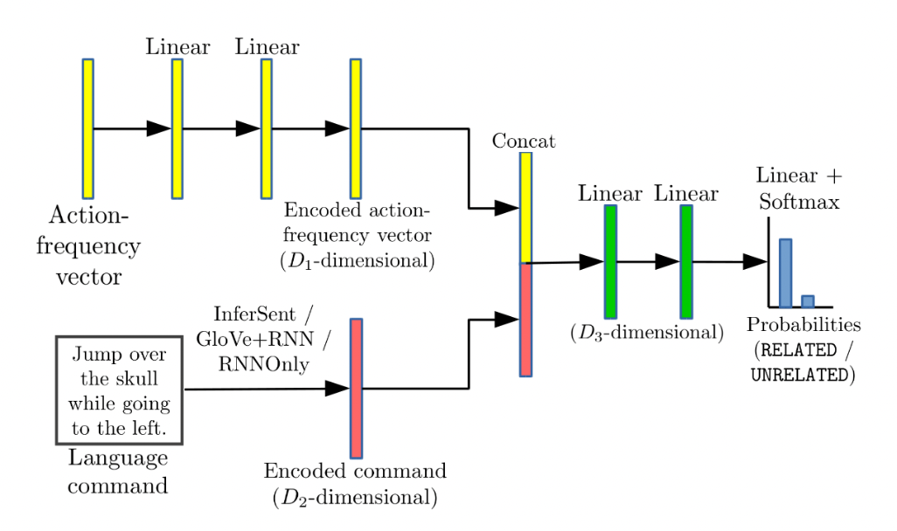
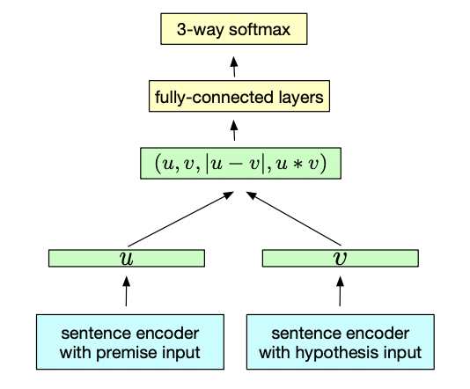
LEARN
Model
Create action-frequency vectors from a given trajectory.
Language Encoder
InferSent
Neural Network Architecture

Slide 12
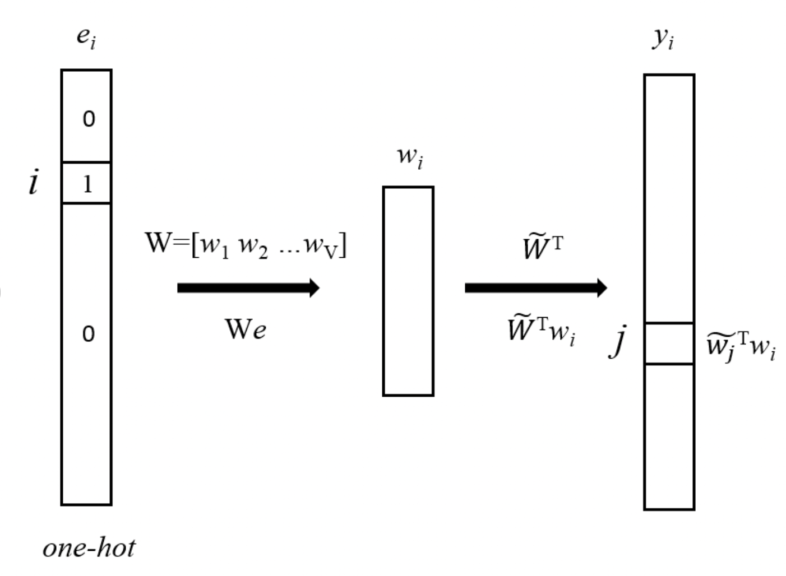
LEARN
GloVe+RNN
Train a two-layer GRU on encoder on top of it.

Slide 13
LEARN
RNNOnly
Randomly initialize word vectors.
Train word embeddings and two-layer GRU encoder.
Training procedure
Used Adam optimizer for backpropagation

Slide 14
LEARN
Data collection for training LEARN
Generated trajectories
Gave natural language annotations from human annotators for each trajectory – Used Amazon Mechanical Turk.
Obtained 6,870 language descriptions

Slide 15
Language-aided RL
Probabilities P_{R} and P_{U} are used to define intermediate rewards.
For mapping the probabilities to language-based shaping rewards:
φ(f_{t}) = P_{R}(f_{t}) − P_{U}(f_{t})
Intermediate language-based reward: R_{lang}(f_{t}) = γ · φ(f_{t}) − φ(f_{t-1})

Slide 16
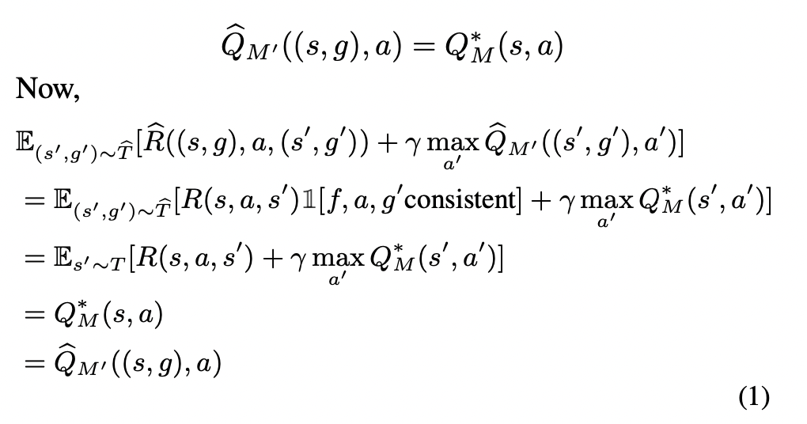
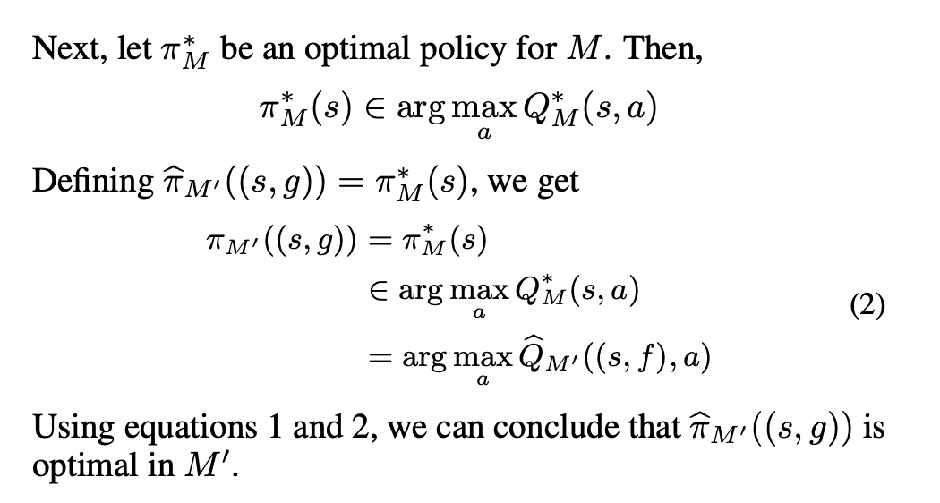
Language-aided RL
Proof: Policy that is optimal under the original reward function (R_{ext}) is also optimal under the new reward function (R_{ext} + R_{lang})

Slide 17
Experimental Setup
Data collection:
Created a training dataset with 160,000 (action-frequency vector, language) pairs and a validation dataset with 40,000 pairs.
15 diverse tasks – each task had a reference trajectory upon which language commands were collected.
Used PPO on-policy algorithm and trained for 500k timesteps.

Slide 18
Experimental Setup
RL setups
ExtOnly: Original environment reward, without using language-based reward.
Ext+Lang: Original environment reward with language-based reward.
Metrics
(Area under curve) AUC: Number of timesteps vs number of successes from each policy training run.
Final policy: Policy evaluation by recording number of successful episodes after using the learned policy for additional 10k timesteps.

Slide 19
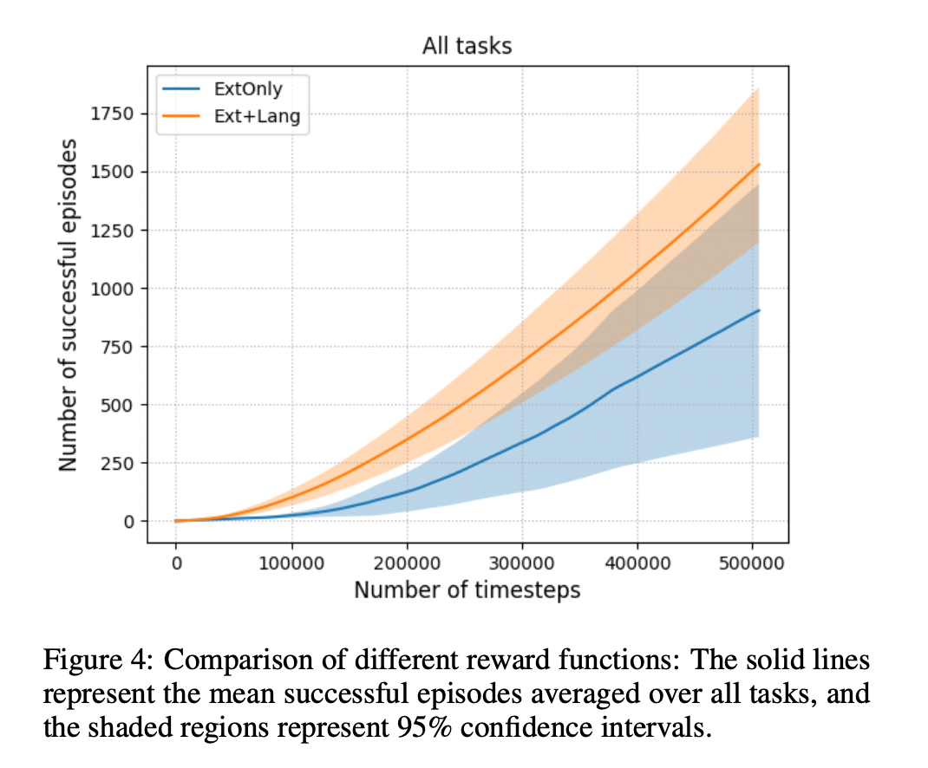
Experimental Results

Slide 20
Experimental Results
Ext+Lang completes 1529.43 episodes on average, compared to 903.12 for ExtOnly, thereby giving a 60% relative improvement.
AUC: Out of 15 tasks, Ext+Lang performs well in 11 of them, poorly in 1, and with no difference in 3.
Final policy: Ext+Lang outperforms ExtOnly in 8 out of 15 tasks, with the difference in performance being non-significant in the other 7.

Slide 21
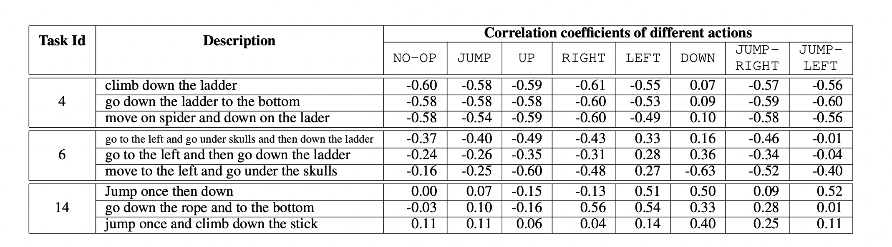
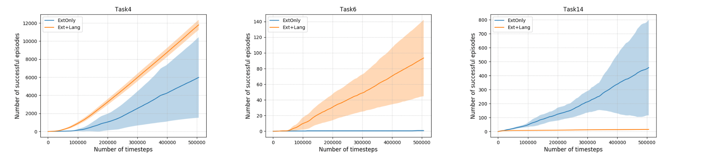
Analysis of Language-based Rewards

Slide 22
Observations
Task 4:
Simple descriptions – ‘Down’ positively correlated with language-based rewards – Aids exploration
Task 6:
Complex descriptions – language-based rewards correctly align with actions for first two descriptions – improvement in AUC for the first two descriptions, while no statistically significant difference for the third description.
Task 14:
Failure case – Language rewards not well-correlated with descriptions – Groundings involving the word ‘jump’ are noisy.
Notes:
We hypothesize that this is because (i) the JUMP action typically appears with other actions like LEFT and RIGHT, and (ii) humans would typically use similar words to refer to JUMP, JUMP-LEFT and JUMP-RIGHT actions. These factors make it harder for the network to learn correct associations.

Slide 23
Discussion of Results
Improves the efficiency of policy training on average.
Helps learn a better final policy for sparse reward settings.
Agnostic to the choice of RL algorithm.
Can be used by non-experts to specify tasks to RL agents.
Since it learns to map language to a reward function offline, it could be beneficial if the interaction with the environment is expensive.
Better performance than the standard MDP setup.

Slide 24
Limitations
Temporal ordering:
Aggregates the sequence of past actions into an action-frequency vector, thereby losing temporal information.
State-based rewards:
Cannot utilize natural language descriptions that refer to objects in the state.
Multi-step instructions:
Current approach only handles single instruction.
Involves manual intervention.

Slide 25
Critique
Cannot be adapted in a highly dynamic environment with multiple factors and variables that a language command could not possibly encompass.
Method does not address suboptimal policy issues.
Does not describe the impact of varying λ.
Does not describe how the method handles contextual differences in a language command (other issues related to semantic analysis too).
Scaling to complex environments and instructions might be difficult (but the authors claim otherwise).

Slide 26
Future Work for Paper / Reading
Issues due to exclusion of states and actions spaces being discrete in the current approach are addressed in ‘PixL2R: Guiding Reinforcement Learning Using Natural Language by Mapping Pixels to Rewards’.
‘Language as a Cognitive Tool to Imagine Goals in Curiosity-Driven Exploration’ discusses an approach where an agent sets its own goal and learns its own internal reward function without being dependent on any external instruction.

Slide 27
Extended Readings
PixL2R: Guiding Reinforcement Learning Using Natural Language by Mapping Pixels to Rewards.
Enabling Robots to Understand Incomplete Natural Language Instructions Using Commonsense Reasoning.
Guiding Safe Reinforcement Learning Policies Using Structured Language Constraints.
The RobotSlang Benchmark: Dialog-guided Robot Localization and Navigation.
Principled reward shaping for reinforcement learning via lyapunov stability theory.
Language as a Cognitive Tool to Imagine Goals in Curiosity-Driven Exploration.

Slide 28
Summary
Problem -> How to design a reward function that is effective and accurately describes the tasks?
Agents are deprived of instantaneous rewards in sparse reward settings and could end up spending significant amount of time exploring whereas dense rewards are difficult to specify.
Prior works are either labor-intensive or are difficult to scale in complex environments.
The authors propose a Framework which takes arbitrary natural language and the trajectory executed by the agent and makes prediction whether agent is following the instruction or not.
They design a two-stage approach: i) LanguagE-Action Reward Network (LEARN) and ii) Language-aided RL and implement the approach on Atari game Montezuma’s Revenge to validate the effectiveness.
The approach can be used to train faster and learn a better policy for sparse reward settings.

